Slide 1


HELP NEEDY

Slide 2
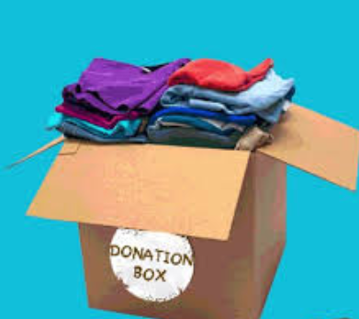
Giving is not just about making a donation. It is about making a difference

Slide 3
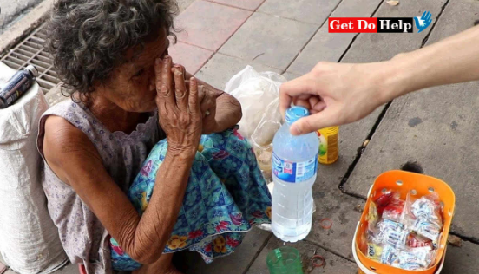
HOW WE WORK
Help Needy makes it super easy for you to make non-cash donations. We all have a lot of clothes, books, and other household goods just lying at some corner and getting dusted. It’s time to give them a new life by donating them to those who in need and bring smiles on their faces!! Now Spreading Happiness is just a click away!!

Slide 4
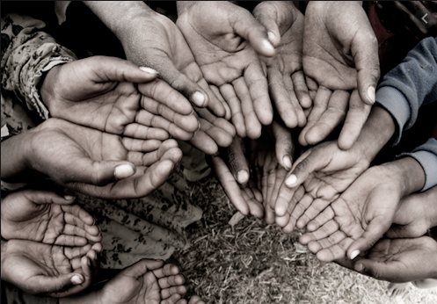
OUR STORY
Help Needy provides you with the most convenient and easy way to donate those items that are just lying at some corner of your house, gathering dust and taking up some much-needed space. It’s time to donate them and give those books, toys, clothes etc a new life.
There are many benefits to donating your old stuff to NGOs.

Slide 5
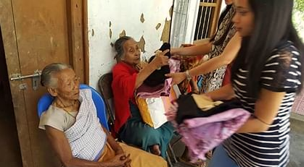

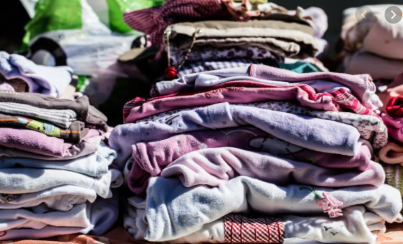
WHAT WE OFFER Books Clothes

Slide 6

SHARE POINTS
Get rewarded for every step you take in your giving journey with Help Needy! “Share Points” is our way of thanking you for all the happiness you spread by giving away your unwanted goods to someone in need.
Give away unwanted goods
Earn and accumulate “Share points”
Redeem for exclusive rewards

